Slide 1
Neoliberal Economics and its effects by: Carston Maher

Slide 2
How do neoliberal policies affect economic outcomes?

Slide 3
Variable Selection

Slide 4
Neoliberal Policy Indices
Heritage Economic Freedom Index
Potential for Variable Bias
Reverse Causality
Fraser Economic Freedom of the World
Less Bias Concern
Similar Reverse Causality Concern

Slide 5
How I adjusted
Cross Validated
Disaggregated the index
Lagged the index
Clustered by region
Notes:
Heritage Index
Disaggregated the index into its 12 components to identify which subdimensions were driving results.
Lagged the index by 1–3 years to reduce reverse causality concerns.
Controlled for country fixed effects and clustered standard errors by region to mitigate structural differences.
Fraser Index
Analyzed each of the 5 areas separately to isolate domain-specific effects.
Cross-validated results with Heritage Index to check for robustness.
Accounted for outdated inputs (e.g., Doing Business data) and adjusted for perception-based bias using alternative control variables.

Slide 6
Selecting Dependent Variables
Using the World Banks World Development Index I Selected 43 Initial Variables
Poverty & Inequality | Health & Access | Macro
Gini Index | Access to clean cooking fuel | GDP, GDP per capital
Income Share (top and bottom 10%) | Spending > 10%/20% on Health | GNI, Exports
Headcount Poverty Ratio | % pushed into Poverty by Healthcare Expenditure | GDP/GNI Growth
Poverty Gaps | Social Insecurity | CPI
Below 50% of Median Income | Account Ownership (Poorest 40%) | CO2 Emissions

Slide 7
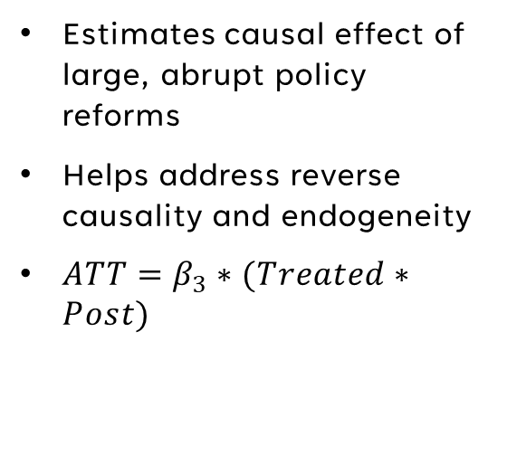
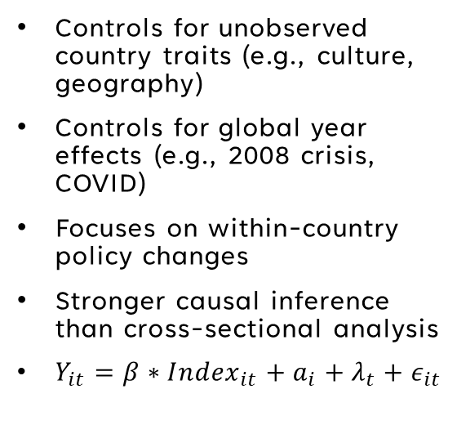
Regression Methods
Simple Linear Regression
Fixed Effects Panel Model
Difference In Difference
Ran 86 separate OLS regressions for each outcome variable on each index
Captured: coefficient, p-value, and R² and sorted by most significant results
Fails to capture country level effects and differences
Doesn’t show the effects of making a policy change
Controls for unobserved country traits (e.g., culture, geography)
Controls for global year effects (e.g., 2008 crisis, COVID)
Focuses on within-country policy changes
Stronger causal inference than cross-sectional analysis
$Y_{it}=β∗{Index}_{it}+a_{i}+λ_{t}+ε_{it}$
Estimates causal effect of large, abrupt policy reforms
Helps address reverse causality and endogeneity
$ATT=β_{3}∗(Treated∗Post)$

Slide 8
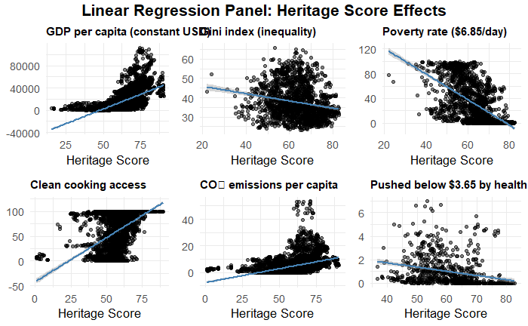

Slide 9
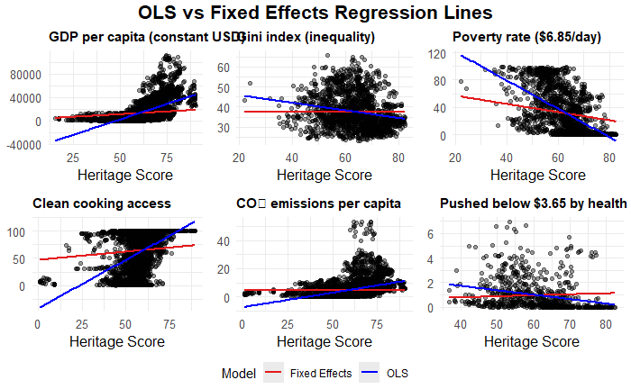

Slide 10
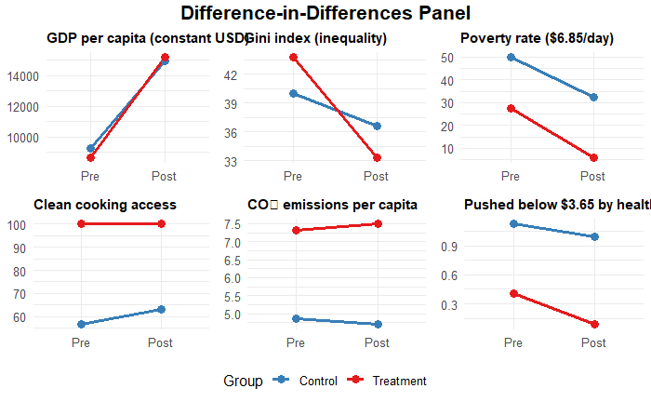

Slide 11
Conclusions
Significant positive associations found between Fraser and Heritage scores and the Gini index — especially in dimensions related to reduced government size and fiscal restraint.
From the Data
More to Explore
Neoliberal reforms produce uneven economic outcomes
Poverty-related indicators yield mixed results
Significant positive associations found between Fraser and Heritage scores and the Gini index — especially in dimensions related to reduced government size and fiscal restraint.
DiD results confirm large changes matter more
Are countries reforming because of poor outcomes, or are the outcomes a result of reform?
How does region impact results?
Dive into case studies

Slide 12
THANK YOU

